Slide 1

Heart Disease Prediction Using Logistic Regression
Predicting the likelihood of heart disease using clinical parameters.
Presented by: Rishi Kedia
Institution: Techno India University

Slide 2

Understanding Heart Disease
What is Coronary Artery Disease (CAD)?
CAD involves the narrowing of blood vessels that supply the heart, leading to reduced blood flow.
Why Early Prediction Matters
Timely identification of CAD risk allows for crucial early interventions, improving patient outcomes and quality of life.

Slide 3



Symptoms & Risk Factors
Key Symptoms
Primary Risk Factors
Chest pain (Angina)
Age & Sex
Breathlessness (Dyspnea)
High Cholesterol
Persistent fatigue
High Blood Pressure
Heart palpitations
Smoking history
Obesity & lifestyle

Slide 4



Dataset Overview: UCI Heart Disease
The model was developed using the UCI Heart Disease dataset, a publicly available resource for cardiac research.
Features Utilized
Age, Sex, Chest Pain (CP)
Resting Blood Pressure (Trestbps)
Cholesterol (Chol), Fasting Blood Sugar (FBS)
Resting Electrocardiographic Results (RestECG)
Maximum Heart Rate Achieved (Thalach)
Exercise Induced Angina (Exang)
ST Depression Induced by Exercise (Oldpeak)
Slope of the Peak Exercise ST Segment (Slope)
Number of Major Vessels Colored by Fluoroscopy (CA)
Thalassemia (Thal)
Target Variable
Disease Presence:
0 = No Heart Disease
1 = Presence of Heart Disease

Slide 5

Data Preprocessing Pipeline
Rigorous preprocessing ensures data quality and model performance.
01
Missing Value Handling
Imputation strategies were applied to address any missing data points, preventing bias and preserving data integrity.
02
Categorical Encoding
Categorical features were transformed into numerical representations suitable for machine learning algorithms, primarily using one-hot encoding.
03
Feature Scaling
Numerical features were scaled (e.g., Standardization) to normalize their ranges, which is crucial for algorithms like Logistic Regression.
04
Train-Test Split (70/30)
The dataset was partitioned into training (70%) and testing (30%) sets to evaluate the model's generalization capabilities on unseen data.

Slide 6





Model Workflow: From Data to Prediction
1. Load Dataset
Initial ingestion of the structured heart disease data.
2. Preprocess Data
Cleaning, transforming, and scaling of features.
3. Train Logistic Regression
The model learns patterns from the preprocessed training data.
4. Predict
Utilizing the trained model to forecast outcomes on new data.
5. Evaluate Model
Assessing performance using various metrics.

Slide 7
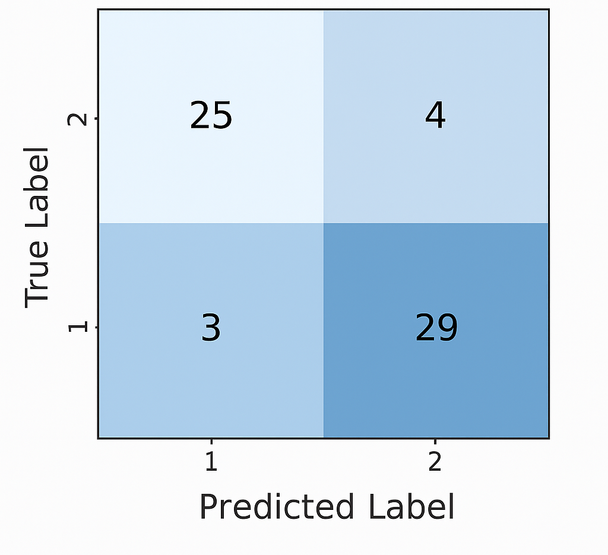
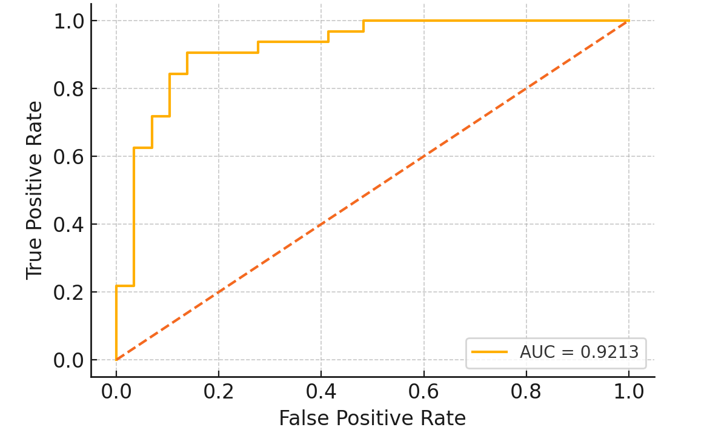

Model Performance Metrics
Comprehensive evaluation confirms the model's predictive power.
0.88
0.89
0.88
0.87
Accuracy
Precision
Recall
F1 Score
Overall proportion of correct predictions.
Ability of the model to identify only relevant data points.
Ability of the model to find all relevant cases.
Harmonic mean of precision and recall, balancing both.
Confusion Matrix
ROC Curve
Actual Negative
True Negative (TN)
False Positive (FP)
Actual Positive
False Negative (FN)
True Positive (TP)

Slide 8

Predicting for a New Patient
Required Inputs
The model requires the same 13 clinical features as the training data for accurate prediction.
Example Patient Input
A hypothetical patient profile is fed into the trained model (e.g., Age: 55, Sex: Male, Chol: 240, etc.).
Probability Output
The model outputs a probability (e.g., 0.75) indicating the likelihood of heart disease.
Prediction Threshold
If probability > 0.5 (configurable threshold), the patient is predicted to have heart disease.

Slide 9

Why Logistic Regression?
Logistic Regression is well-suited for binary classification tasks in clinical contexts due to its distinct advantages.
High Interpretability
Probability Output
Binary Classification Efficacy
The coefficients of logistic regression models can be directly interpreted, offering clear insights into feature importance and their impact on disease probability. This transparency is crucial for clinical acceptance.
Unlike some other classifiers, Logistic Regression provides a probability score, not just a class label. This allows clinicians to assess the confidence of a prediction, aiding in nuanced decision-making and risk stratification.
As heart disease prediction is a binary outcome (presence/absence), Logistic Regression is a natural fit. It efficiently models the relationship between clinical predictors and the dichotomous target variable.

Slide 10

Conclusion & Future Work
Conclusion
Future Work
The developed Logistic Regression model effectively predicts heart disease based on clinical parameters.
Explore advanced machine learning algorithms (e.g., Random Forest, XGBoost) for potential performance enhancements.
This predictive capability supports early clinical intervention, enabling proactive patient management.
Develop an intuitive dashboard for clinicians to easily input patient data and visualize predictions.
Integrate with wearable devices for real-time data collection and continuous risk assessment, fostering preventative care.

